Slide 1
Utilizing the WebRTC P2P protocol to reduce infrastructure costs of media streaming
Jan Ivkovic

Slide 2
Streaming of videos
Live videos being shared online on various platforms
YouTube live/Twitch
Packets of the video being transmitted

Slide 3
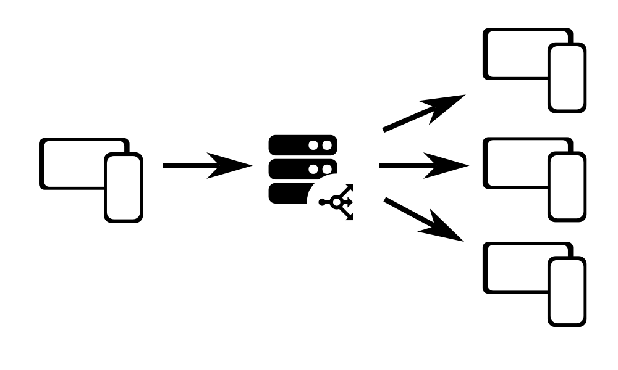
Traditional streaming server architecture
Data streamed from one user to many via a network of company servers
Problem of the Cost of infrastructure
Cost optimization

Slide 4
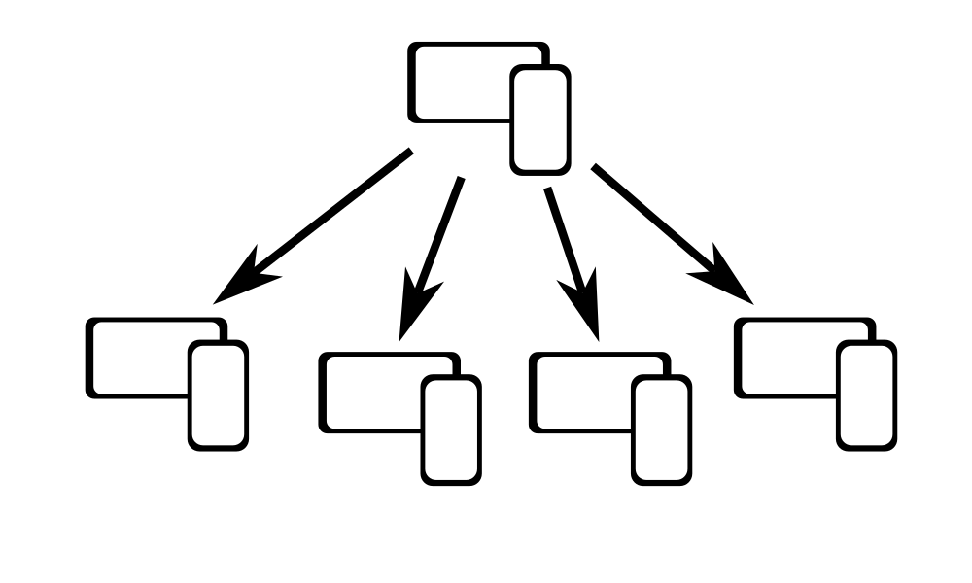
Alternative model - P2P
No server!

Slide 5
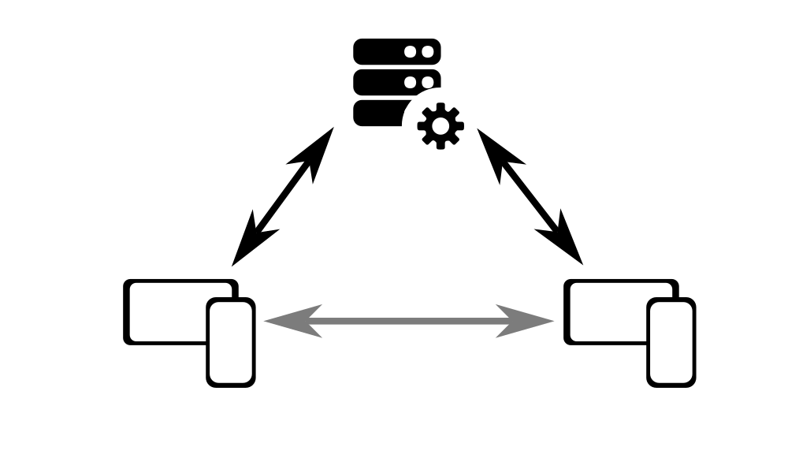
P2P options
WebRTC example of P2P
More complex than just from one user to another
Still requires servers to create connection
Limits of peer performance

Slide 6
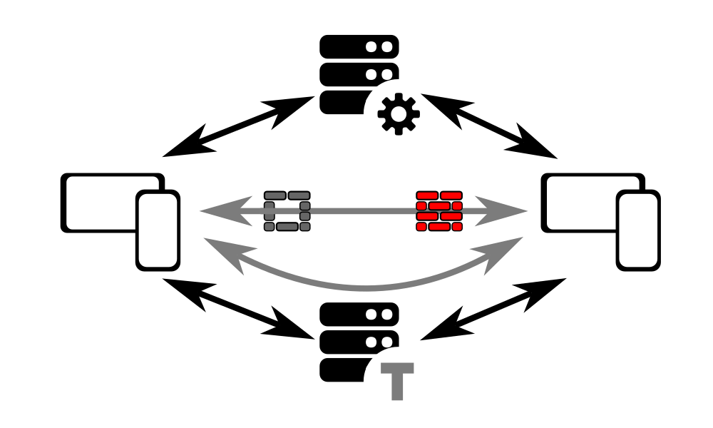
WebRTC

Slide 7
Target audience
Individuals/companies working on platform development
Companies improving their platforms
Researchers working on P2P networking
Researchers working on server economics

Slide 8
Literary review
Odlyzko, A. M. (2003). Internet traffic growth: sources and implications. Optical Transmission Systems and Equipment for WDM Networking II. Retrieved from: https://doi.org/10.1117/12.512942
Feldmann, A., Gasser, O., Lichtblau, F., Pujol, E., Poese, I., Dietzel, C., Wagner, D., Wichtlhuber, M., Tapiador, J., Vallina-Rodriguez, N., Hohlfeld, O., and Smaragdakis, G. (2021). A Year in Lockdown: How the Waves of COVID-19 Impact Internet Traffic. Communications of the ACM 64, 7 (July 2021).
Nunez, L., and Toasa, R., M. (2020). Performance evaluation of RTMP, RTSP and HLS protocols for IPTV in mobile networks. 15th Iberian Conference on Information Systems and Technologies (CISTI). Seville, Spain, 2020, pp. 1-5. Retrieved from: https://ieeexplore.ieee.org/abstract/document/9140848

Slide 9
Literary review
De Cicco, L., and Mascolo, S. (2014). An Adaptive Video Streaming Control System: Modeling, Validation, and Performance Evaluation. IEEE/ACM Transactions on Networking, vol. 22, no. 2, pp. 526-539, April 2014. Retrieved from: https://ieeexplore.ieee.org/abstract/document/6493502?casa_token=Rk4Txz8YKu8AAAAA:1uBUmdk0c38SyLakINnm08yM3q33O63O9wRvlXJeJLt7QTViXoObKtNrq43TLzRlL3-uqYcf
Durak, K., Akcay, M., N., Erinc, Y., K., Pekel, B., and Begen, A., C. (2020). Evaluating the Performance of Apple’s Low-Latency HLS IEEE 22nd International Workshop on Multimedia Signal Processing (MMSP), Tampere, Finland, 2020, pp. 1-6. Retrieved from: https://ieeexplore.ieee.org/abstract/document/9287117
Sanni, M., L., Hashim, A., A., Anwar, F., Ahmed, G., S., M., and Ali, S. (2013). How to model wireless mesh networks topology. IOP Conference Series: Materials Science and Engineering, Volume 53, 5th International Conference on Mechatronics (ICOM'13) 2–4 July 2013, Kuala Lumpur, Malaysia. Retrieved from: https://iopscience.iop.org/article/10.1088/1757-899X/53/1/012037/meta

Slide 10
Literary review
Ramos-Chavez, R., Karagkioules, T., and Mekuria, R. (2020). A scalable load generation framework for evaluation of video streaming workflows in the cloud. In Proceedings of the 11th ACM Multimedia Systems Conference (MMSys '20). Association for Computing Machinery, New York, NY, USA, 255–260. https://doi.org/10.1145/3339825.3394930

Slide 11
Main questions
Feasibility – can such a system exist/work
Cost efficiency – is the proposed model better in terms of reducing load (on servers)
Limitations and scalability – is the model feasible due to technological limitations of client devices (loss of connection with too many peers)

Slide 12
Methodology – cost efficiency
Does it reduce load on servers?
Use a benchmark (HLS) and compare to WebRTC
Run tests of streaming on both (benchmark and P2P) and measuring the load on servers in the size of packets being transmitted on the servers

Slide 13
Methodology – cost efficiency 2
Transmit using both HLS and WebRTC models videos of 640x480, 1280x720 and 1920x1080
Increase the load on the servers by one extra peer per second
Measure with a task manager like application (Nethogs)

Slide 14
Methodology – cost efficiency 3

Slide 15
Methodology– Limitations/scalability
Same setup of increasing clients by one each second
Record each packet received by a client with a timestamp
Calculate the number of packets received per second by each peer from the timestamps

Slide 16
Methodology– Limitations/scalability

Slide 17
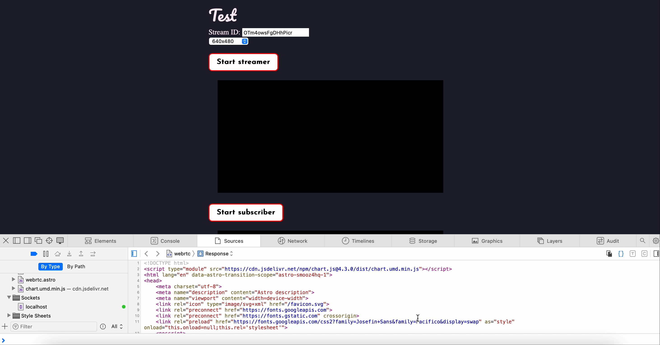
Methodology– Limitations/scalability

Slide 18
Methodology– Limitations/scalability
0 | 1699335805848 | 1 | 1699335806151
1 | 1699335806060 | 0 | 1699335806152
0 | 1699335806069 | 1 | 1699335806162
1 | 1699335806110 | 0 | 1699335806167
0 | 1699335806116 | 1 | 1699335806561
1 | 1699335806123 | 1 | 1699335806573
0 | 1699335806127 | 1 | 1699335806585
1 | 1699335806136 | 1 | 1699335806597
0 | 1699335806139 | New client: | 2
Peer 0: 7 packets
Peer 1: 10 packets
Start timestamp:
1699335805848
End timestamp:
1699335806597

Slide 19
Methodology– Limitations/scalability
Peer 0: 7/(1699335806597-1699335805848)*1000=
9.34 packets per second
Peer 1: 10/(1699335806597-1699335805848)*1000=
13.35 packets per second
Average: 11.35 packets per second
Peer 0: 7 packets
Peer 1: 10 packets
Start timestamp:
1699335805848
End timestamp:
1699335806597

Slide 20
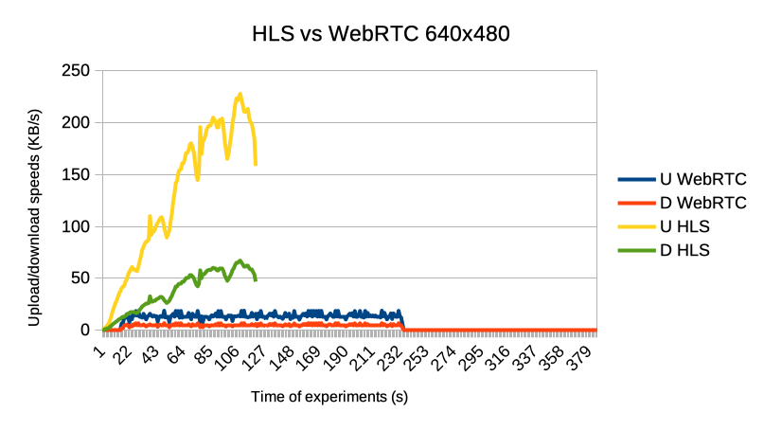
Results – network load

Slide 21
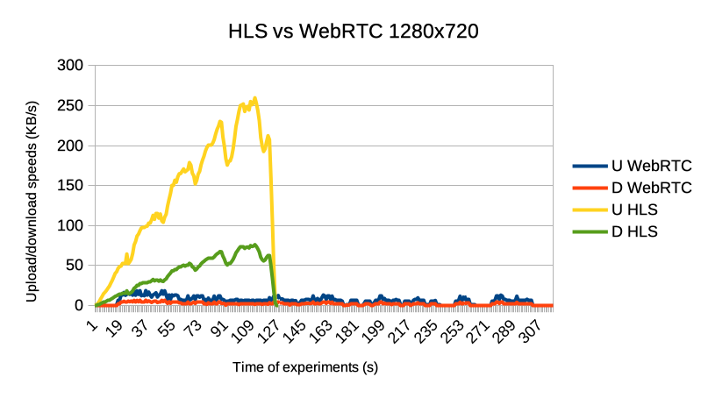
Results – network load

Slide 22
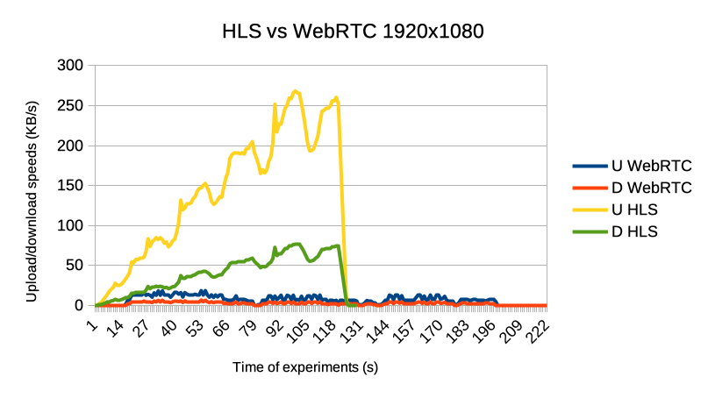
Results – network load

Slide 23
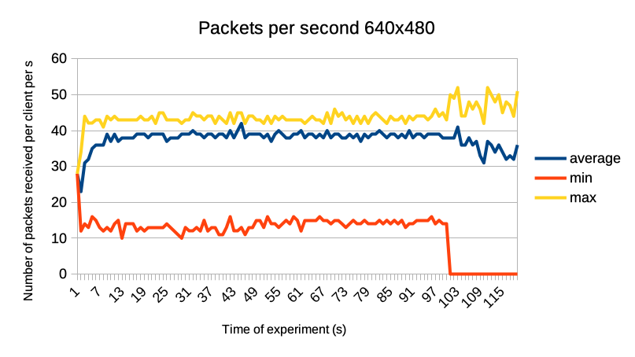
Results - packets

Slide 24
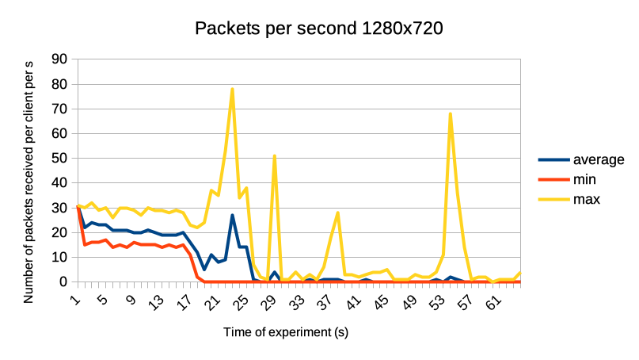
Results - packets

Slide 25
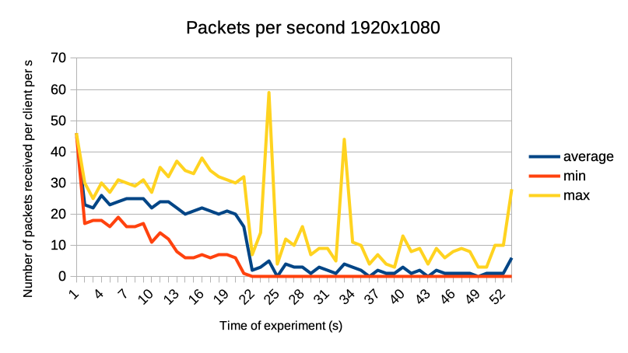
Results - packets

Slide 26
Evaluation 1
Possible to create such a system
It is more cost efficient
Severe limitations (17 connections at 1280 by 720 pixels, 10 connections at 1920 by 1080 pixels)

Slide 27
Evaluation 2
In reality both HLS and WebRTC likely have linear cost correlation to the number of peers
Multi layer approach a possible workaround

Slide 28
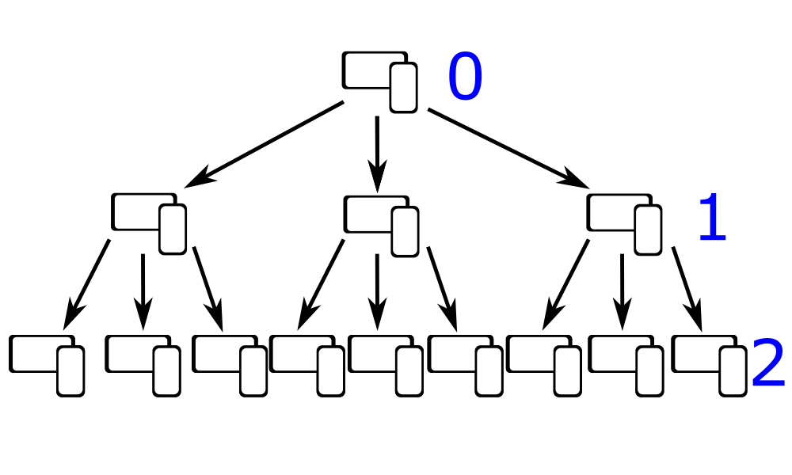
Evaluation 3

Slide 29
Conclusion
It is possible to use this proposed alternative streaming method
There are some severe limitations but workarounds are possible

